Slide 2
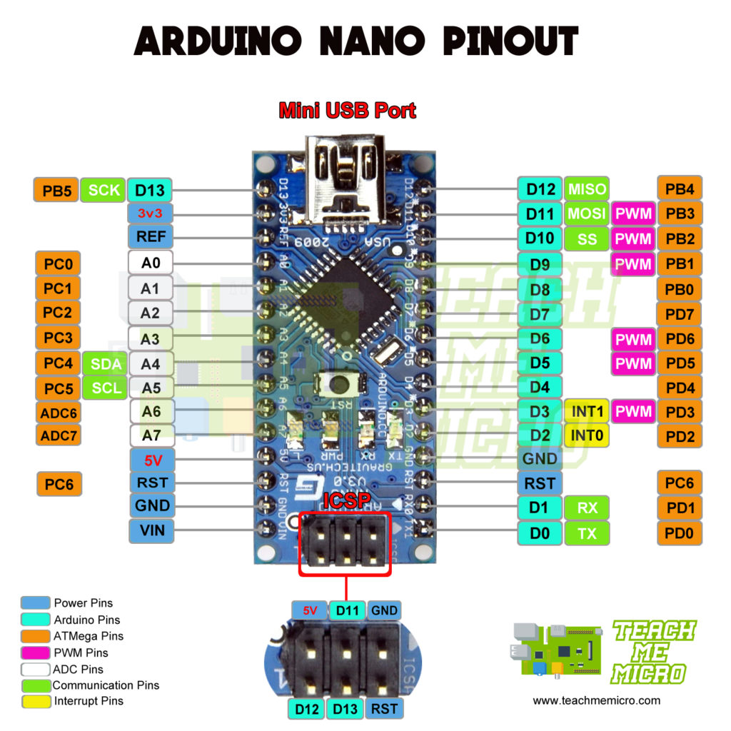
SDA
SCK
MOSI
MISO
R0
GND
RST
3.3v
MFRC522
Switch Mode Button
D13
5V
Btn
SCL
SDA
VCC
GND
LED

Slide 3
